Slide 1
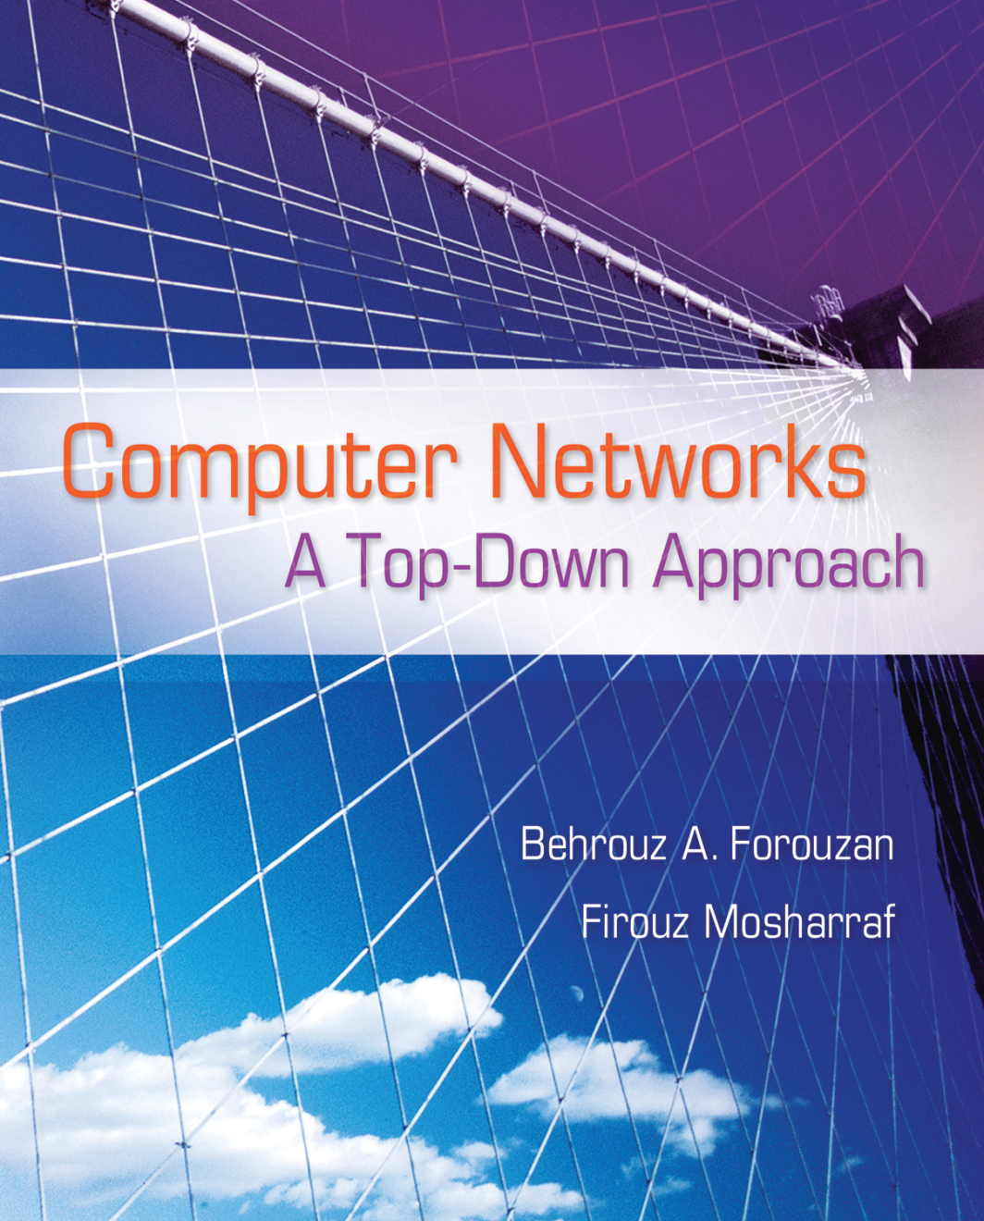
Chapter 3
Transport Layer
3.<number>
.

Slide 2
Chapter 3: Outline
3.1 INTRODUCTION
3.2 TRANSPORT-LAYER PROTOCOLS
3.3 USER DATAGRAM PROTOCOL
3.4 TRANSMISSION CONTROL PROTOCOL
3.<number>

Slide 3
Chapter 3: Objective
We introduce general services we normally require from the transport layer, such as process-to-process communication, addressing, multiplexing, error, flow, and congestion control.
We discuss general transport-layer protocols such as Stop-and-Wait, Go-Back-N, and Selective-Repeat.
We discuss UDP, which is the simpler of the two protocols we discuss in this chapter.
We discuss TCP services and features. We then show how TCP provides a connection-oriented service using a transition diagram. Finally, we discuss flow and error control, and congestion control in TCP.
3.<number>
Notes:
1.#

Slide 4
    3-1 INTRODUCTION
The transport layer provides a process-to-process communication between two application layers. Communication is provided using a logical connection, which means that the two application layers assume that there is an imaginary direct connection through which they can send and receive messages.
3.<number>

Slide 5
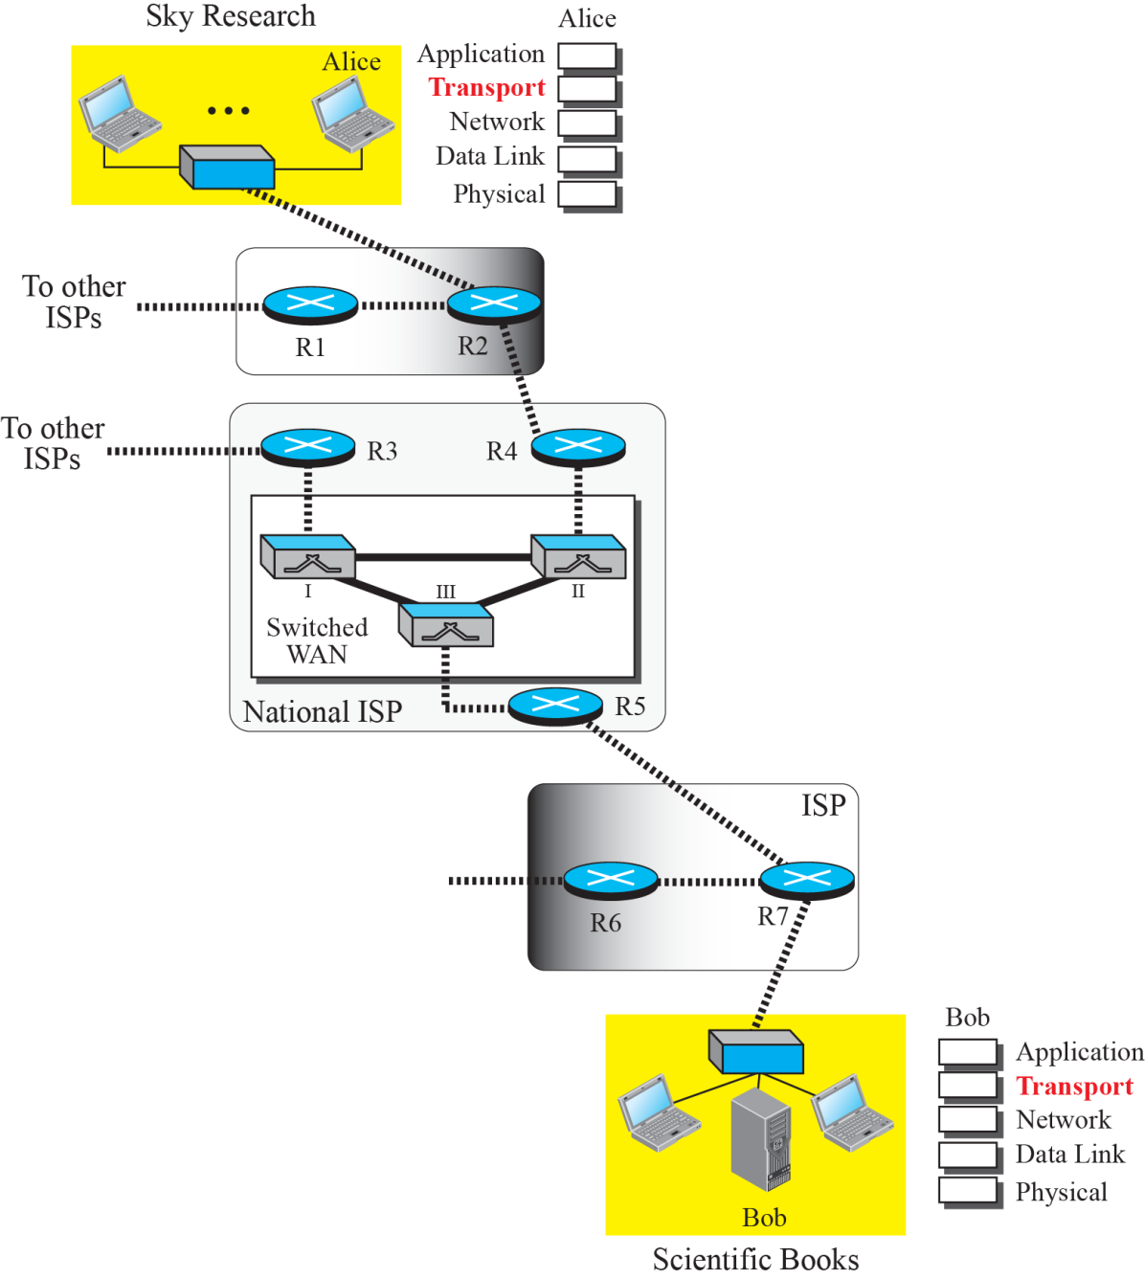
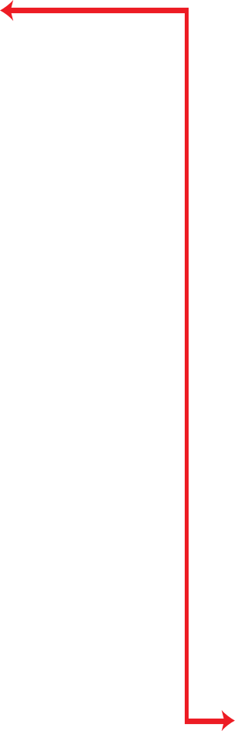

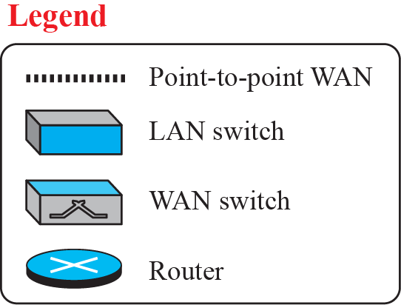
Figure 3.1: Logical connection at the transport layer
3.<number>

Slide 6
3.1.1 Transport-Layer Services
As we discussed in Chapter 1, the transport layer is located between the network layer and the application layer. The transport layer is responsible for providing services to the application layer; it receives services from the network layer. In this section, we discuss the services that can be provided by the transport layer; in the next section, we discuss several transport-layer protocols.
3.<number>

Slide 7
3.1.1 (continued)
Process-to-Process Communication
Addressing: Port Numbers
ICANN Ranges
Well-known ports
Registered ports
Dynamic ports
Encapsulation and Decapsulation
Multiplexing and Demultiplexing
3.<number>

Slide 8
3.1.1 (continued)
Flow Control
Pushing or Pulling
Flow Control at Transport Layer
Buffers
Error Control
Sequence Numbers
Acknowledgment
Combination of Flow and Error Control
Sliding Window
3.<number>
Multiplexing and Demultiplexing

Slide 9
3.1.1 (continued)
Congestion Control
Connectionless and Connection-Oriented
Connectionless Service
Connection-Oriented Service
Finite State Machine
Multiplexing and Demultiplexing
3.<number>
Notes:
1.#

Slide 10
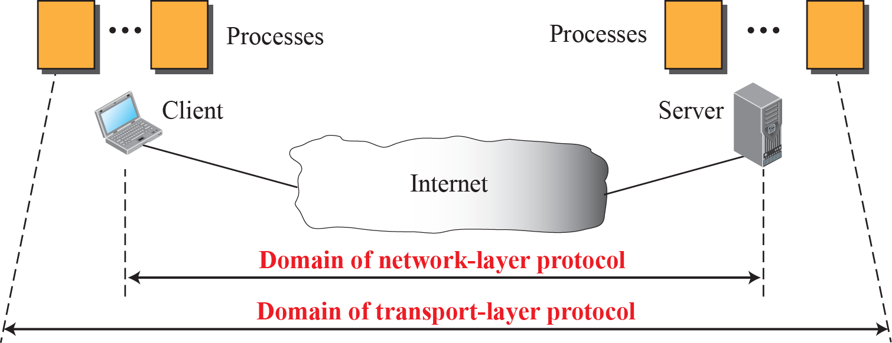
Figure 3.2: Network layer versus transport layer
3.<number>
Notes:
1.#

Slide 11
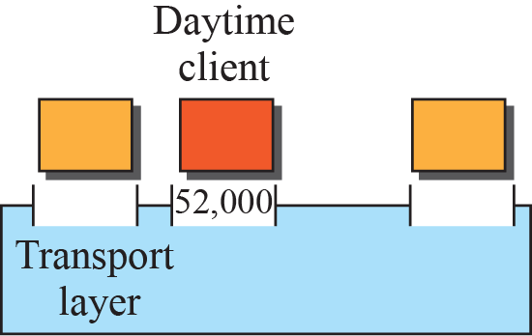
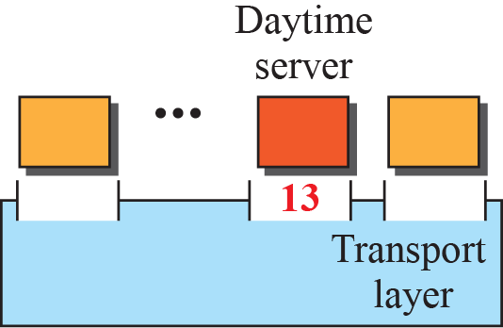
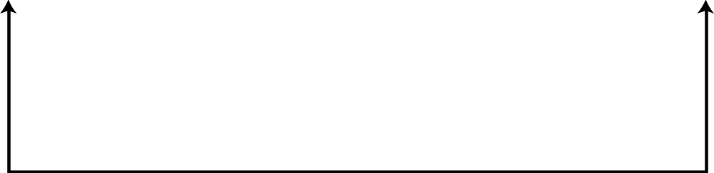

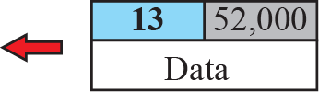
Figure 3.3: Port numbers
3.<number>
Notes:
1.#

Slide 12
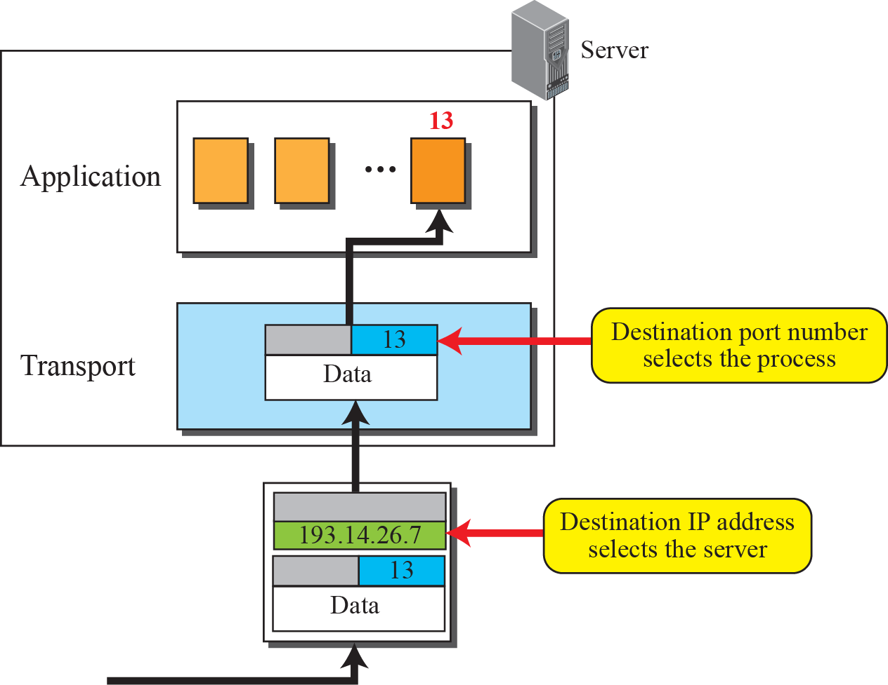
Figure 3.4: IP addresses versus port numbers
3.<number>
Notes:
1.#

Slide 13
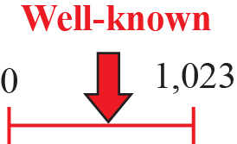
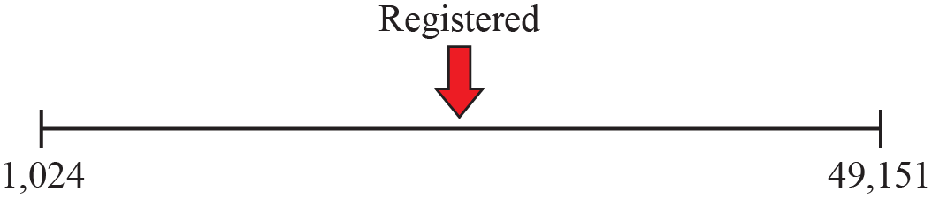
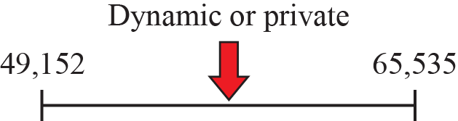
Figure 3.5: ICANN ranges
3.<number>
Notes:
1.#

Slide 14
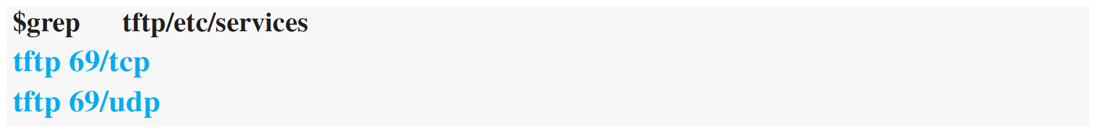
Example 3.1
In UNIX, the well-known ports are stored in a file called /etc/services. We can use the grep utility to extract the line corresponding to the desired application.
SNMP (see Chapter 9) uses two port numbers (161 and 162), each for a different purpose.
3.<number>

Slide 15
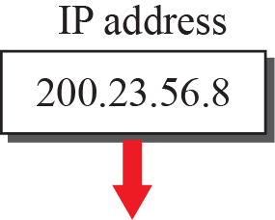
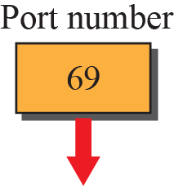
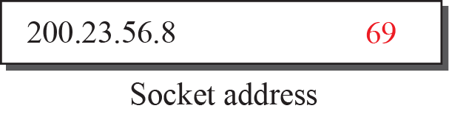
Figure 3.6: Socket address
3.<number>
Notes:
1.#

Slide 16
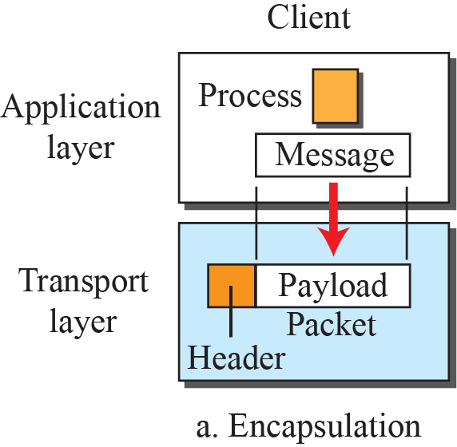
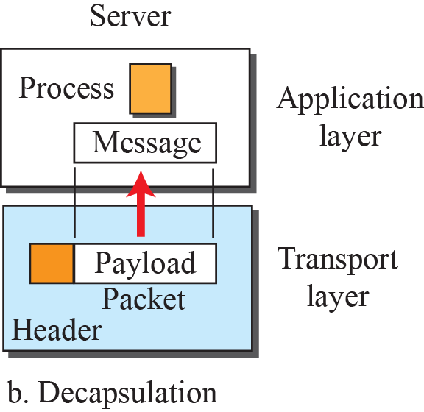
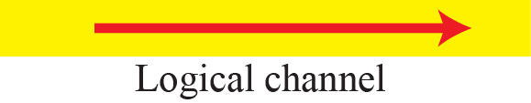
Figure 3.7: Encapsulation and decapsulation
3.<number>
Notes:
1.#

Slide 17
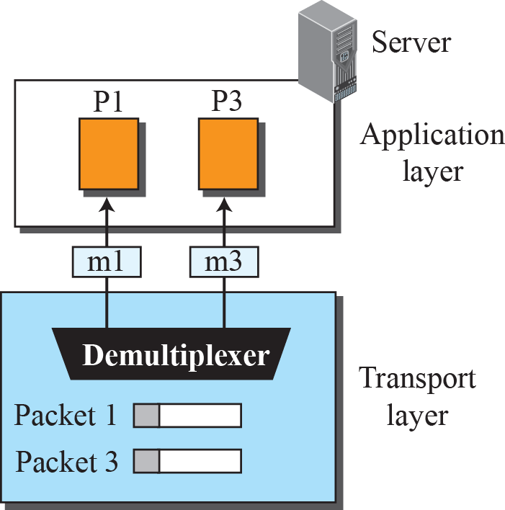
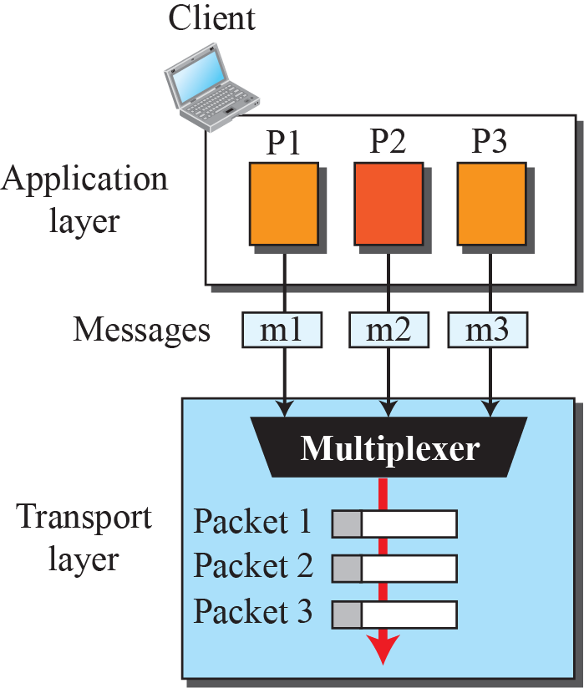
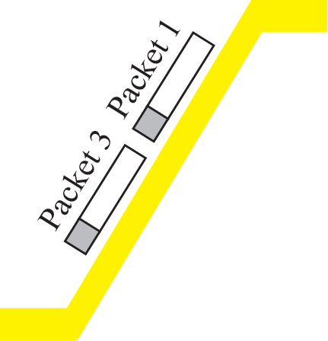
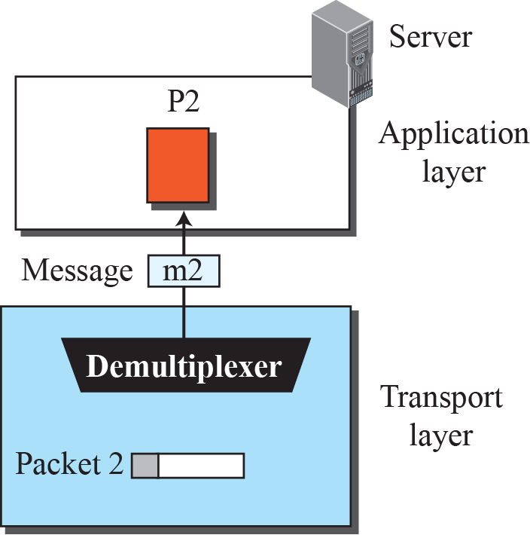
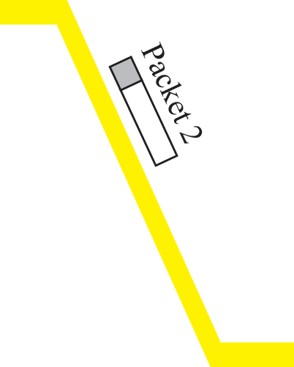
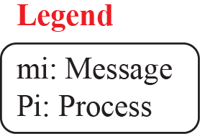
Figure 3.8: Multiplexing and demultiplexing
3.<number>
Notes:
1.#

Slide 18
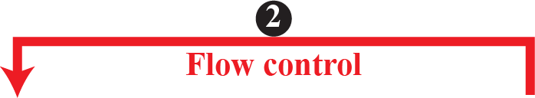
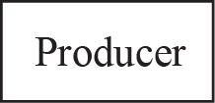
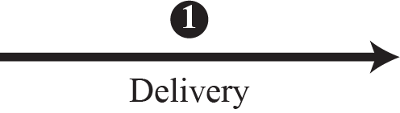
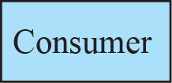

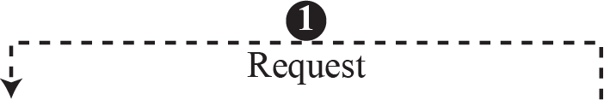
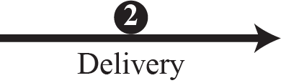

Figure 3.9: Pushing or pulling
3.<number>
Notes:
1.#

Slide 19
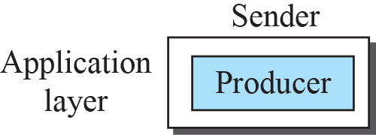
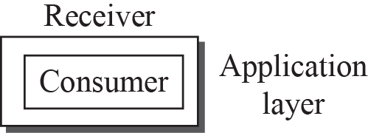
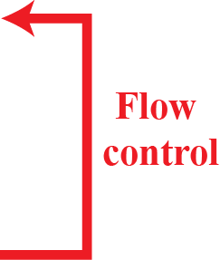
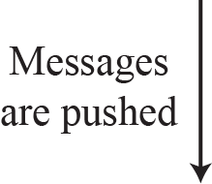
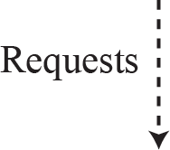
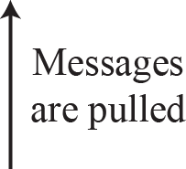
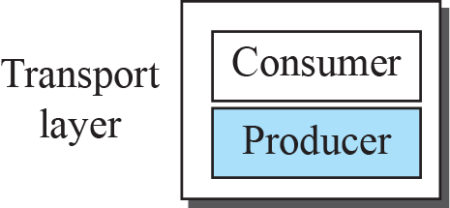
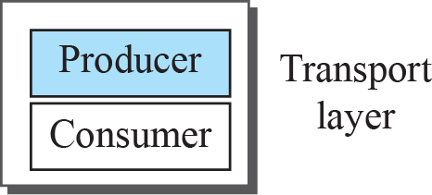
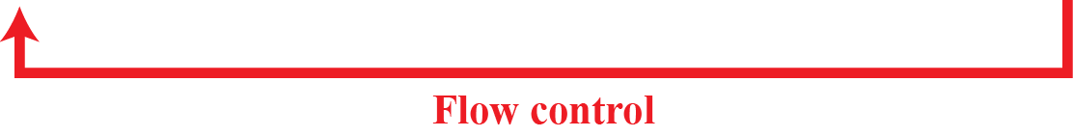
Figure 3.10: Flow control at the transport layer
3.<number>
Notes:
1.#

Slide 20
Example 3.2
The above discussion requires that the consumers communicate with the producers on two occasions: when the buffer is full and when there are vacancies. If the two parties use a buffer with only one slot, the communication can be easier. Assume that each transport layer uses one single memory location to hold a packet. When this single slot in the sending transport layer is empty, the sending transport layer sends a note to the application layer to send its next chunk; when this single slot in the receiving transport layer is empty, it sends an acknowledgment to the sending transport layer to send its next packet. As we will see later, however, this type of flow control, using a single-slot buffer at the sender and the receiver, is inefficient.
3.<number>

Slide 21
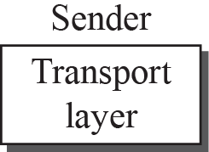
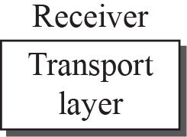
Figure 3.11: Error control at the transport layer
3.<number>
Notes:
1.#

Slide 22
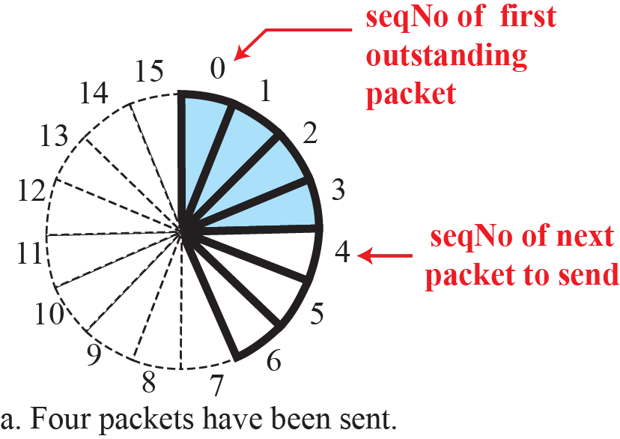
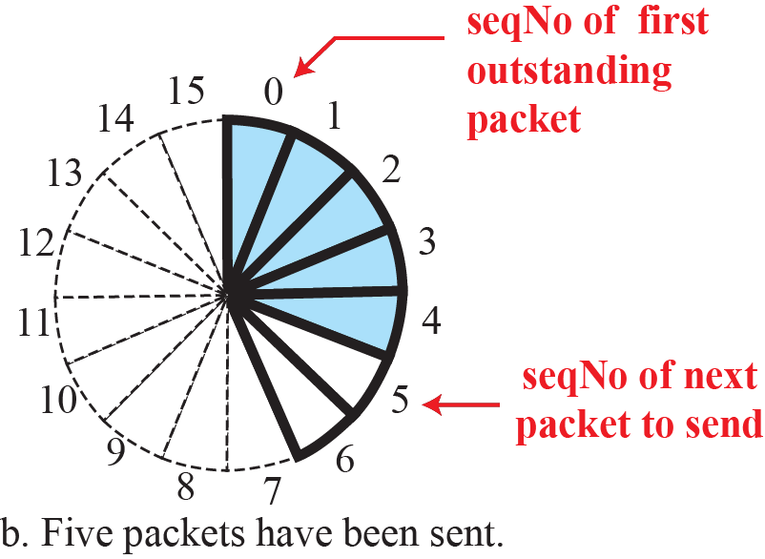
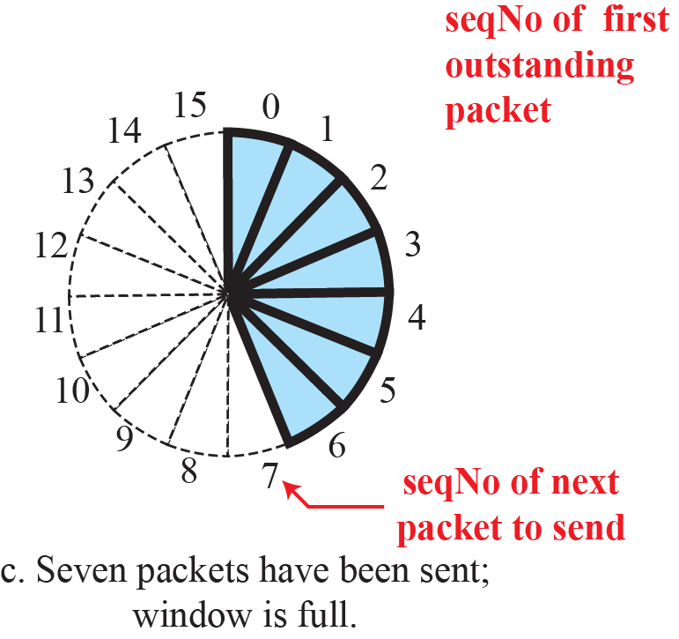
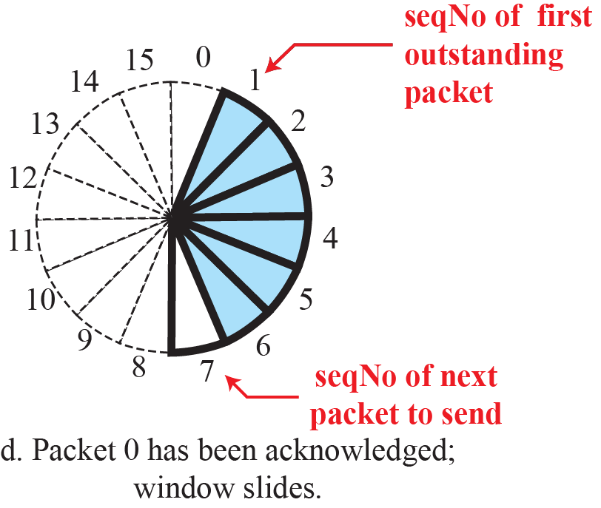
Figure 3.12: Sliding window in circular format
3.<number>
Notes:
1.#

Slide 23
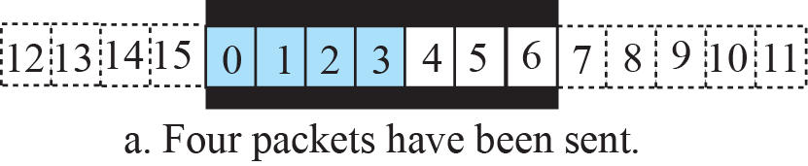
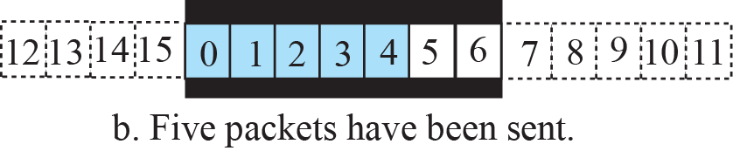
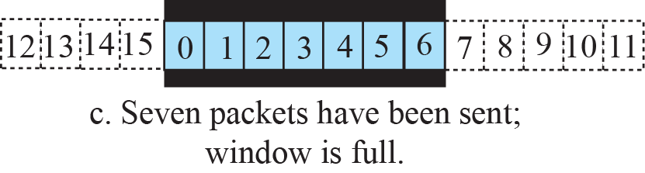

Figure 3.13: Sliding window in linear format
3.<number>
Notes:
1.#

Slide 24









Figure 3.14: Connectionless service
3.<number>
Notes:
1.#

Slide 25
















Figure 3.15: Connection-oriented service
3.<number>
Notes:
1.#

Slide 26



Figure 3.16: Connectionless and connection-oriented service
represented as FSMs
3.<number>
Notes:
1.#

Slide 27
    3-2 TRANSPORT-LAYER PROTOCOLS
We can create a transport-layer protocol by combining a set of services described in the previous sections. To better understand the behavior of these protocols, we start with the simplest one and gradually add more complexity.
3.<number>
Notes:
1.#

Slide 28
3.2.1 Simple Protocol
Our first protocol is a simple connectionless protocol with neither flow nor error control. We assume that the receiver can immediately handle any packet it receives. In other words, the receiver can never be overwhelmed with incoming packets. Figure 3.17 shows the layout for this protocol.
FSMs
3.<number>
Notes:
1.#

Slide 29




Figure 3.17: Simple protocol
3.<number>
Notes:
1.#

Slide 30


Figure 3.18: FSMs for the simple protocol
3.<number>
Notes:
1.#

Slide 31
Example 3.3
Figure 3.19 shows an example of communication using this protocol. It is very simple. The sender sends packets one after another without even thinking about the receiver.
3.<number>

Slide 32






Figure 3.19: Flow diagram for Example 3.3
3.<number>
Notes:
1.#

Slide 33
3.2.2 Stop-and-Wait Protocol
Our second protocol is a connection-oriented protocol called the Stop-and-Wait protocol, which uses both flow and error control. Both the sender and the receiver use a sliding window of size 1. The sender sends one packet at a time and waits for an acknowledgment before sending the next one. To detect corrupted packets, we need to add a checksum to each data packet. When a packet arrives at the receiver site,
3.<number>
Notes:
1.#

Slide 34
3.2.2 (continued)
Sequence Numbers
Acknowledgment Numbers
FSMs
Sender
Receiver
Efficiency
Pipelining
3.<number>
Notes:
1.#

Slide 35






Figure 3.20: Stop-and-Wait protocol
3.<number>
Notes:
1.#

Slide 36


Figure 3.21: FSM for the Stop-and-Wait protocol
3.<number>
Notes:
1.#

Slide 37
Example 3.4
Figure 3.22 shows an example of the Stop-and-Wait protocol. Packet 0 is sent and acknowledged. Packet 1 is lost and resent after the time-out. The resent packet 1 is acknowledged and the timer stops. Packet 0 is sent and acknowledged, but the acknowledgment is lost. The sender has no idea if the packet or the acknowledgment is lost, so after the time-out, it resends packet 0, which is acknowledged.
3.<number>

Slide 38

Figure 3.22: Flow diagram for Example 3.4
3.<number>
Notes:
1.#

Slide 39
Example 3.5
Assume that, in a Stop-and-Wait system, the bandwidth of the line is 1 Mbps, and 1 bit takes 20 milliseconds to make a round trip. What is the bandwidth-delay product? If the system data packets are 1,000 bits in length, what is the utilization percentage of the link?
Solution
The bandwidth-delay product is (1 × 10⁶) × (20 × 10⁻³) = 20,000 bits. The system can send 20,000 bits during the time it takes for the data to go from the sender to the receiver and the acknowledgment to come back. However, the system sends only 1,000 bits. The link utilization is only 1,000/20,000, or 5 percent.
3.<number>

Slide 40
Example 3.6
What is the utilization percentage of the link in Example 3.5 if we have a protocol that can send up to 15 packets before stopping and worrying about the acknowledgments?
Solution
The bandwidth-delay product is still 20,000 bits. The system can send up to 15 packets or 15,000 bits during a round trip. This means the utilization is 15,000/20,000, or 75 percent. Of course, if there are damaged packets, the utilization percentage is much less because packets have to be resent.
3.<number>

Slide 41
3.2.3 Go-Back-N Protocol
To improve the efficiency of transmission multiple packets must be in transition while the sender is waiting for acknowledgment. In this section, we discuss one protocol that can achieve this goal; in the next section, we discuss a second. The first is called Go-Back-N (GBN) (the rationale for the name will become clear later).
3.<number>
Notes:
1.#

Slide 42
3.2.3 (continued)
Sequence Numbers
Acknowledgment Numbers
Send Window
Receive Window
Timers
Resending packets
3.<number>
Notes:
1.#

Slide 43
3.2.3 (continued)
FSMs
Sender
Receiver
Send Window Size
Go-Back-N versus Stop-and-Wait
3.<number>
Notes:
1.#

Slide 44

Figure 3.23: Go-Back-N protocol
3.<number>
Notes:
1.#

Slide 45

Figure 3.24: Send window for Go-Back-N
3.<number>
Notes:
1.#

Slide 46


Figure 3.25: Sliding the send window
Sliding direction
3.<number>
Notes:
1.#

Slide 47

Figure 3.26: Receive window for Go-Back-N
3.<number>
Notes:
1.#

Slide 48


Figure 3.27: FSMs for the Go-Back-N protocol
3.<number>
Notes:
1.#

Slide 49


Figure 3.28: Send window size for Go-Back-N
3.<number>
Notes:
1.#

Slide 50
Example 3.7
Figure 3.29 shows an example of Go-Back-N. This is an example of a case where the forward channel is reliable, but the reverse is not. No data packets are lost, but some ACKs are delayed and one is lost. The example also shows how cumulative acknowledgments can help if acknowledgments are delayed or lost.
3.<number>

Slide 51

Figure 3.29: Flow diagram for Example 3.7
3.<number>
Notes:
1.#

Slide 52
Example 3.8
Figure 3.30 shows what happens when a packet is lost. Packets 0, 1, 2, and 3 are sent. However, packet 1 is lost. The receiver receives packets 2 and 3, but they are discarded because they are received out of order (packet 1 is expected). When the receiver receives packets 2 and 3, it sends ACK1 to show that it expects to receive packet 1. However, these ACKs are not useful for the sender because the ackNo is equal to S_{f}, not greater that S_{f} . So the sender discards them. When the time-out occurs, the sender resends packets 1, 2, and 3, which are acknowledged.
3.<number>

Slide 53

Figure 3.30: Flow diagram for Example 3.8
3.<number>
Notes:
1.#

Slide 54
3.2.4 Selective-Repeat Protocol
The Go-Back-N protocol simplifies the process at the receiver. The receiver keeps track of only one variable, and there is no need to buffer out-of-order packets; they are simply discarded. Another protocol, called the Selective-Repeat (SR) protocol, has been devised, which, as the name implies, resends only selective packets, those that are actually lost. The outline of this protocol is shown in Figure 3.31.
3.<number>
Notes:
1.#

Slide 55
3.2.4 (continued)
Windows
Timer
Acknowledgments
FSMs
Sender
Receiver
3.<number>
Notes:
1.#

Slide 56


Figure 3.31: Outline of Selective-Repeat
3.<number>
Notes:
1.#

Slide 57

Figure 3.32: Send window for Selective-Repeat protocol
3.<number>
Notes:
1.#

Slide 58

Figure 3.33: Receive window for Selective-Repeat protocol
3.<number>
Notes:
1.#

Slide 59
Example 3.9
Assume a sender sends 6 packets: packets 0, 1, 2, 3, 4, and 5. The sender receives an ACK with ackNo = 3. What is the interpretation if the system is using GBN or SR?
Solution
If the system is using GBN, it means that packets 0, 1, and 2 have been received uncorrupted and the receiver is expecting packet 3. If the system is using SR, it means that packet 3 has been received uncorrupted; the ACK does not say anything about other packets.
3.<number>

Slide 60


Figure 3.34: FSMs for SR protocol
3.<number>
Notes:
1.#

Slide 61
Example 3.10
This example is similar to Example 3.8 (Figure 3.30) in which packet 1 is lost. We show how Selective-Repeat behaves in this case. Figure 3.35 shows the situation.
At the sender, packet 0 is transmitted and acknowledged. Packet 1 is lost. Packets 2 and 3 arrive out of order and are acknowledged. When the timer times out, packet 1 (the only unacknowledged packet) is resent and is acknowledged. The send window then slides.
3.<number>

Slide 62
Example 3.10 (continued)
At the receiver site we need to distinguish between the acceptance of a packet and its delivery to the application layer. At the second arrival, packet 2 arrives and is stored and marked (shaded slot), but it cannot be delivered because packet 1 is missing. At the next arrival, packet 3 arrives and is marked and stored, but still none of the packets can be delivered. Only at the last arrival, when finally a copy of packet 1 arrives, can packets 1, 2, and 3 be delivered to the application layer. There are two conditions for the delivery of packets to the application layer: First, a set of consecutive packets must have arrived. Second, the set starts from the beginning of the window.
3.<number>

Slide 63

Figure 3.35: Flow diagram for Example 3.10
3.<number>
Notes:
1.#

Slide 64


Figure 3.36: Selective-Repeat, window size
3.<number>
Notes:
1.#

Slide 65
3.2.5 Bidirectional Protocols
The four protocols we discussed earlier in this section are all unidirectional: data packets flow in only one direction and acknowledgments travel in the other direction. In real life, data packets are normally flowing in both directions: from client to server and from server to client. This means that acknowledgments also need to flow in both directions. A technique called piggybacking is used to improve the efficiency of the bidirectional protocols.
3.<number>
Notes:
1.#

Slide 66





Figure 3.37: Design of piggybacking in Go-Back-N
3.<number>
Notes:
1.#

Slide 67
3.2.6 Internet Transport-Layer Protocols
A network is the interconnection of a set of devices capable of communication. In this definition, a device can be a host such as a large computer, desktop, laptop, workstation, cellular phone, or security system. A device in this definition can also be a connecting device such as a router a switch, a
modem that changes the form of data, and so on.
3.<number>
Notes:
1.#

Slide 68

Figure 3.38: Position of transport-layer protocols in the TCP/IP
protocol suite
3.<number>
Notes:
1.#

Slide 69


Table 3.1: Some well-known ports used with UDP and TCP
3.<number>

Slide 70
    3-3 USER DATAGRAM PROTOCOL (UDP)
The User Datagram Protocol (UDP) is a connectionless, unreliable transport protocol. It does not add anything to the services of IP except for providing process-to-process instead of host-to-host communication. UDP is a very simple protocol using a minimum of overhead.
3.<number>
Notes:
1.#

Slide 71
3.3.1 User Datagram
UDP packets, called user datagrams, have a fixed size header of 8 bytes made of four fields, each of 2 bytes (16 bits). Figure 3.39 shows the format of a user datagram. The first two fields define the source and destination port numbers. The third field defines the total length of the user datagram, header plus data. The 16 bits can define a total length of 0 to 65,535 bytes.
3.<number>
Notes:
1.#

Slide 72




Figure 3.39: User datagram packet format
3.<number>
Notes:
1.#

Slide 73

Example 3.11
The following is the contents of a UDP header in hexadecimal format.
a. What is the source port number?
b. What is the destination port number?
c. What is the total length of the user datagram?
d. What is the length of the data?
e. Is the packet directed from a client to a server or vice
versa?
f. What is the client process?
3.<number>

Slide 74
Example 3.11 (continue)
Solution
a. The source port number is the first four hexadecimal
digits (CB84)₁₆ or 52100
b. The destination port number is the second four
hexadecimal digits (000D)₁₆ or 13.
c. The third four hexadecimal digits (001C)₁₆ define the
length of the whole UDP packet as 28 bytes.
d. The length of the data is the length of the whole packet
minus the length of the header, or 28 − 8 = 20 bytes.
e. Since the destination port number is 13 (well-known
port), the packet is from the client to the server.
f. The client process is the Daytime (see Table 3.1).
3.<number>

Slide 75
3.3.2 UDP Services
Earlier we discussed the general services provided by a transport-layer protocol. In this section, we discuss what portions of those general services are provided by UDP.
Process-to-Process Communication
Connectionless Services
Flow Control
Error Control
3.<number>
Notes:
1.#

Slide 76
3.3.2 (continued)
Checksum
Optional Inclusion of Checksum
Congestion Control
Encapsulation and Decapsulation
Queuing
Multiplexing and Demultiplexing
Comparison : UDP and Simple Protocol
3.<number>
Notes:
1.#

Slide 77

Figure 3.40: Pseudoheader for checksum calculation
3.<number>
Notes:
1.#

Slide 78
Example 3.12
What value is sent for the checksum in one of the following hypothetical situations?
a. The sender decides not to include the checksum.
b. The sender decides to include the checksum, but the
value of the sum is all 1s.
c. The sender decides to include the checksum, but the
value of the sum is all 0s.
3.<number>

Slide 79
Example 3.12 (continued)
Solution
a. The value sent for the checksum field is all 0s to show
that the checksum is not calculated.
b. When the sender complements the sum, the result is all
0s; the sender complements the result again before
sending. The value sent for the checksum is all 1s. The
second complement operation is needed to avoid
confusion with the case in part a.
c. This situation never happens because it implies that the
value of every term included in the calculation of the
sum is all 0s, which is impossible; some fields in the
pseudoheader have nonzero values.
3.<number>

Slide 80
3.3.3 UDP Applications
Although UDP meets almost none of the criteria we mentioned earlier for a reliable transport-layer protocol, UDP is preferable for some applications. The reason is that some services may have some side effects that are either unacceptable or not preferable. An application designer sometimes needs to compromise to get the optimum.
In this section, we first discuss some features of UDP that may need to be considered when one designs an application program and then show some typical applications.
3.<number>
Notes:
1.#

Slide 81
3.3.3 (continued)
UDP Features
Connectionless Service
Lack of Error Control
Lack of Congestion Control
Typical Applications
3.<number>
Notes:
1.#

Slide 82
Example 3.13
A client-server application such as DNS (see Chapter 2) uses the services of UDP because a client needs to send a short request to a server and to receive a quick response from it. The request and response can each fit in one user datagram. Since only one message is exchanged in each direction, the connectionless feature is not an issue; the client or server does not worry that messages are delivered out of order.
3.<number>

Slide 83
Example 3.14
A client-server application such as SMTP (see Chapter 2), which is used in electronic mail, cannot use the services of UDP because a user can send a long e-mail message, which may include multimedia (images, audio, or video). If the application uses UDP and the message does not fit in one single user datagram, the message must be split by the application into different user datagrams. Here the connectionless service may create problems. The user datagrams may arrive and be delivered to the receiver application out of order. The receiver application may not be able to reorder the pieces. This means the connectionless service has a disadvantage for an application program that sends long messages.
3.<number>

Slide 84
Example 3.15
Assume we are downloading a very large text file from the Internet. We definitely need to use a transport layer that provides reliable service. We don’t want part of the file to be missing or corrupted when we open the file. The delay created between the deliveries of the parts is not an overriding concern for us; we wait until the whole file is composed before looking at it. In this case, UDP is not a suitable transport layer.
3.<number>

Slide 85
Example 3.16
Assume we are using a real-time interactive application, such as Skype. Audio and video are divided into frames and sent one after another. If the transport layer is supposed to resend a corrupted or lost frame, the synchronizing of the whole transmission may be lost. The viewer suddenly sees a blank screen and needs to wait until the second transmission arrives. This is not tolerable. However, if each small part of the screen is sent using one single user datagram, the receiving UDP can easily ignore the corrupted or lost packet and deliver the rest to the application program. That part of the screen is blank for a very short period of time, which most viewers do not even notice.
3.<number>

Slide 86
    3-4 TRANSMISSION CONTROL PROTOCOL
Transmission Control Protocol (TCP) is a connection-oriented, reliable protocol. TCP explicitly defines connection establishment, data transfer, and connection teardown phases to provide a connection-oriented service. TCP uses a combination of GBN and SR protocols to provide reliability.
3.<number>
Notes:
1.#

Slide 87
3.4.1 TCP Services
A Before discussing TCP in detail, let us explain the services offered by TCP to the processes at the application layer.
Process-to-Process Communication
Stream Delivery Service
Sending and Receiving Buffers
Segments
3.<number>
Notes:
1.#

Slide 88
3.4.1 (continued)
Full-Duplex Communication
Multiplexing and Demultiplexing
Connection-Oriented Service
Reliable Service
3.<number>
Notes:
1.#

Slide 89



Figure 3.41: Stream delivery
3.<number>
Notes:
1.#

Slide 90




Figure 3.42: Sending and receiving buffers
3.<number>
Notes:
1.#

Slide 91

Figure 3.43: TCP segments
3.<number>
Notes:
1.#

Slide 92
3.4.2 TCP Features
To provide the services mentioned in the previous section, TCP has several features that are briefly summarized in this section and discussed later in detail.
Numbering System
Byte Number
Sequence Number
Acknowledgment Number
3.<number>
Notes:
1.#

Slide 93

Example 3.17
Suppose a TCP connection is transferring a file of 5,000 bytes. The first byte is numbered 10,001. What are the sequence numbers for each segment if data are sent in five segments, each carrying 1,000 bytes?
Solution
The following shows the sequence number for each segment:
3.<number>

Slide 94
3.4.3 Segment
Before discussing TCP in more detail, let us discuss the TCP packets themselves. A packet in TCP is called a segment.
Format
Encapsulation
3.<number>
Notes:
1.#

Slide 95


Figure 3.44: TCP segment format
3.<number>
Notes:
1.#

Slide 96


Figure 3.45: Control field
3.<number>
Notes:
1.#

Slide 97

Figure 3.46: Pseudoheader added to the TCP datagram
3.<number>
Notes:
1.#

Slide 98
3.4.4 A TCP Connection
TCP is connection-oriented. As discussed before, a connection-oriented transport protocol establishes a logical path between the source and destination. All of the segments belonging to a message are then sent over this logical path. Using a single logical pathway for the entire message facilitates the acknowledgment process as well as retransmission of damaged or lost frames.
3.<number>
Notes:
1.#

Slide 99
3.4.4 (continued)
Connection Establishment
Three-Way Handshaking
SYN Flooding Attack
Data Transfer
Pushing Data
Urgent Data
Connection Termination
Three-Way Handshaking
Half-Close
Connection Reset
3.<number>
Notes:
1.#

Slide 100









Figure 3.47: Connection establishment using three-way handshaking
3.<number>
Notes:
1.#

Slide 101










Figure 3.48: Data transfer
3.<number>
Notes:
1.#

Slide 102







Figure 3.49: Connection termination using three-way handshaking
3.<number>
Notes:
1.#

Slide 103



Figure 3.50: Half-close
3.<number>
Notes:
1.#

Slide 104
3.4.5 State Transmission Diagram
To keep track of all the different events happening during connection establishment, connection termination, and data transfer, TCP is specified as the finite state machine (FSM) as shown in Figure 3.51.
Scenarios
A Half-Close Scenario
3.<number>
Notes:
1.#

Slide 105

Figure 3.51: State transition diagram
3.<number>
Notes:
1.#

Slide 106

Table 3.2:States for TCP
3.<number>

Slide 107


Figure 3.52: Transition diagram with half-close connection termination
3.<number>
Notes:
1.#

Slide 108

Figure 3.53: Time-line diagram for a common scenario
3.<number>
Notes:
1.#

Slide 109
3.4.6 Windows in TCP
TCP uses two windows (send window and receive window) for each direction of data transfer, which means four windows for a bidirectional communication. To make the discussion simple, we make an unrealistic unidirectional; the bidirectional communication can be inferred using two unidirectional communications with piggybacking.
Send Window
Receive Window
3.<number>
Notes:
1.#

Slide 110


Figure 3.54: Send window in TCP
3.<number>
Notes:
1.#

Slide 111


Figure 3.55: Receive window in TCP
3.<number>
Notes:
1.#

Slide 112
3.4.7 Flow Control
As discussed before, flow control balances the rate a producer creates data with the rate a consumer can use the data. TCP separates flow control from error control. In this section we discuss flow control, ignoring error control. We assume that the logical channel between the sending and receiving TCP is error-free.
3.<number>
Notes:
1.#

Slide 113
3.4.7 (continued)
Opening and Closing Windows
A Scenario
Shrinking of Windows
Window Shutdown
Silly Window Syndrome
Syndrome Created by the Sender
Syndrome Created by the Receiver
3.<number>
Notes:
1.#

Slide 114







Figure 3.56: Data flow and flow control feedbacks in TCP
3.<number>
Notes:
1.#

Slide 115

Figure 3.57: An example of flow control
3.<number>
Notes:
1.#

Slide 116
Example 3.18
Figure 3.58 shows the reason for this mandate.
Part a of the figure shows the values of the last acknowledgment and rwnd. Part b shows the situation in which the sender has sent bytes 206 to 214. Bytes 206 to 209 are acknowledged and purged. The new advertisement, however, defines the new value of rwnd as 4, in which
210 + 4 < 206 + 12. When the send window shrinks, it creates a problem: byte 214, which has already been sent, is outside the window. The relation discussed before forces the receiver to maintain the right-hand wall of the window to be as shown in part a, because the receiver does not know which of the bytes 210 to 217 has already been sent. described above.
3.<number>

Slide 117


Figure 3.58: Example 3.18
3.<number>
Notes:
1.#

Slide 118
3.4.8 Error Control
TCP is a reliable transport-layer protocol. This means that an application program that delivers a stream of data to TCP relies on TCP to deliver the entire stream to the application program on the other end in order, without error, and without any part lost or duplicated.
3.<number>
Notes:
1.#

Slide 119
3.4.8 (continued)
Checksum
Acknowledgment
Cumulative Acknowledgment (ACK)
Selective Acknowledgment (SACK)
Generating Acknowledgments
Retransmission
Retransmission after RTO
Retransmission after Three Duplicate ACK
Out-of-Order Segments
3.<number>
Notes:
1.#

Slide 120
3.4.8 (continued)
FSMs for Data Transfer in TCP
Sender-Side FSM
Receiver-Side FSM
Some Scenarios
Normal Operation
Lost Segment
Fast Retransmission
Delayed Segment
Duplicate Segment
Automatically Corrected Lost ACK
Correction by Resending a Segment
Deadlock Created by Lost Acknowledgment
3.<number>
Notes:
1.#

Slide 121

Figure 3.59: Simplified FSM for the TCP sender side
3.<number>
Notes:
1.#

Slide 122

Figure 3.60: Simplified FSM for the TCP receiver side
3.<number>
Notes:
1.#

Slide 123

Figure 3.61: Normal operation
3.<number>
Notes:
1.#

Slide 124

Figure 3.62: Lost segment
3.<number>
Notes:
1.#

Slide 125

Figure 3.63: Fast retransmission
3.<number>
Notes:
1.#

Slide 126

Figure 3.64: Lost acknowledgment
3.<number>
Notes:
1.#

Slide 127

Figure 3.65: Lost acknowledgment corrected by resending a segment
3.<number>
Notes:
1.#

Slide 128
3.4.9 TCP Congestion Control
TCP uses different policies to handle the congestion in the network. We describe these policies in this section.
Congestion Window
Congestion Detection
Congestion Policies
Slow Start: Exponential Increase
Congestion Avoidance: Additive Increase
3.<number>
Notes:
1.#

Slide 129
3.4.9 (continued)
Policy Transition
Taho TCP
Reno TCP
NewReno TCP
Additive Increase, Multiplicative Decrease
TCP Throughput
3.<number>
Notes:
1.#

Slide 130

Figure 3.66: Slow start, exponential increase
3.<number>
Notes:
1.#

Slide 131

Figure 3.67: Congestion avoidance, additive increase
3.<number>
Notes:
1.#

Slide 132

Figure 3.68: FSM for Taho TCP
3.<number>
Notes:
1.#

Slide 133
Example 3.19
Figure 3.69 shows an example of congestion control in a Taho TCP. TCP starts data transfer and sets the ssthresh variable to an ambitious value of 16 MSS. TCP begins at the slow-start (SS) state with the cwnd = 1. The congestion window grows exponentially, but a time-out occurs after the third RTT (before reaching the threshold). TCP assumes that there is congestion in the network. It immediately sets the new ssthresh = 4 MSS (half of the current cwnd, which is 8) and begins a new slow start (SA) state with cwnd = 1 MSS. The congestion grows exponentially until it reaches the newly set threshold. TCP now moves to the congestion avoidance (CA) state and the congestion window grows additively until it reaches cwnd = 12 MSS.
3.<number>

Slide 134
Example 3.19 (continued)
At this moment, three duplicate ACKs arrive, another indication of the congestion in the network. TCP again halves the value of ssthresh to 6 MSS and begins a new slow-start (SS) state. The exponential growth of the cwnd continues. After RTT 15, the size of cwnd is 4 MSS. After sending four segments and receiving only two ACKs, the size of the window reaches the ssthresh (6) and the TCP moves to the congestion avoidance state. The data transfer now continues in the congestion avoidance (CA) state until the connection is terminated after RTT 20.
3.<number>

Slide 135

Figure 3.69: Example of Taho TCP
3.<number>
Notes:
1.#

Slide 136

Figure 3.70: FSM for Reno TCP
3.<number>
Notes:
1.#

Slide 137
Example 3.20
Figure 3.71 shows the same situation as Figure 3.69, but in Reno TCP. The changes in the congestion window are the same until RTT 13 when three duplicate ACKs arrive. At this moment, Reno TCP drops the ssthresh to 6 MSS, but it sets the cwnd to a much higher value (ssthresh + 3 = 9 MSS) instead of 1 MSS. It now moves to the fast recovery state. We assume that two more duplicate ACKs arrive until RTT 15, where cwndgrows exponentially. In this moment, a new ACK (not duplicate) arrives that announces the receipt of the lost segment. It now moves to the congestion avoidance state, but first deflates the congestion window to 6 MSS as though ignoring the whole fast-recovery state and moving back to the previous track.
3.<number>

Slide 138

Figure 3.71: Example of a Reno TCP
3.<number>
Notes:
1.#

Slide 139

Figure 3.72: Additive increase, multiplicative decrease (AIMD)
3.<number>
Notes:
1.#

Slide 140

Example 3.21
If MSS = 10 KB (kilobytes) and RTT = 100 ms in Figure 3.72, we can calculate the throughput as shown below.
3.<number>

Slide 141
3.4.10 TCP Timers
To perform their operations smoothly, most TCP implementations use at least four timers.
Retransmission Timer
Round-Trip Time (RTT)
Karn’s Algorithm
Exponential Backoff
Persistence Timer
Keepalive Timer
TIME-WAIT Timer
3.<number>
Notes:
1.#

Slide 142

Example 3.22
Let us give a hypothetical example. Figure 3.73 shows part of a connection. The figure shows the connection establishment and part of the data transfer phases.
1. When the SYN segment is sent, there is no value for
RTTM, RTTS, or RTTD. The value of RTO is set to
6.00 seconds. The following shows the value of these
variables at this moment:
3.<number>

Slide 143

Example 3.22 (continued)
2. When the SYN+ACK segment arrives, RTTM is
measured and is equal to 1.5 seconds. The following
shows the values of these variables:
3.<number>

Slide 144

Example 3.22 (continued)
3. When the first data segment is sent, a new RTT measurement starts. Note that the sender does not start an RTT measurement when it sends the ACK segment, because it does not consume a sequence number and there is no time-out. No RTT measurement starts for the second data segment because a measurement is already in progress.
3.<number>

Slide 145

Figure 3.73: Example 3.22
3.<number>
Notes:
1.#

Slide 146
Example 3.23
Figure 3.74 is a continuation of the previous example. There is retransmission and Karn’s algorithm is applied. The first segment in the figure is sent, but lost. The RTO timer expires after 4.74 seconds. The segment is retransmitted and the timer is set to 9.48, twice the previous value of RTO. This time an ACK is received before the time-out. We wait until we send a new segment and receive the ACK for it before recalculating the RTO (Karn’s algorithm).
3.<number>

Slide 147

Figure 3.74: Example 3.23
3.<number>
Notes:
1.#

Slide 148
3.4.11 Options
The TCP header can have up to 40 bytes of optional information. Options convey additional information to the destination or align other options. These option are included on the book website for further reference.
3.<number>
Notes:
1.#

Slide 149
Chapter 3: Summary
The main duty of a transport-layer protocol is to provide process-to-process communication. To define the processes, we need port numbers. The client program defines itself with an ephemeral port number. The server defines itself with a well-known port number. To send a message from one process to another, the transport-layer protocol encapsulates and decapsulates messages. Flow control balances the exchange of data items between a producer and a consumer. A transport-layer protocol can provide two types of services: connectionless and connection-oriented. In a connectionless service, the sender sends packets to the receiver without any connection establishment. In a connection-oriented service, the client and the server first need to establish a connection between themselves.
3.<number>
Notes:
1.#

Slide 150
Chapter 3: Summary (continued)
We have discussed several common transport-layer protocols in this chapter. The Stop-and-Wait protocol provides both flow and error control, but is inefficient. The Go-Back-N protocol is the more efficient version of the Stop-and-Wait protocol and takes advantage of pipelining. The Selective-Repeat protocol, a modification of the Go-Back-N protocol, is better suited to handle packet loss. All of these protocols can be implemented bidirectionally using piggybacking.
UDP is a transport protocol that creates a process-to-process communication. UDP is a (mostly) unreliable and connectionless protocol that requires little overhead and offers fast delivery. The UDP packet is called a user datagram.
3.<number>
Notes:
1.#

Slide 151
Chapter 3: Summary (continued)
Transmission Control Protocol (TCP) is another transport-layer protocol in the TCP/IP protocol suite. TCP provides process-to-process, full-duplex, and connection-oriented service. The unit of data transfer between two devices using TCP software is called a segment. A TCP connection consists of three phases: connection establishment, data transfer, and connection termination. TCP software is normally implemented as a finite state machine (FSM).
3.<number>
Notes:
1.#

